Slide 1

NextStop
Gets you there!
Aesthetik Designs
Avinash More
Krithika Raghavendran
Nicolas Mauthes
Vikram Deshmukh
Vishrut Sharma
Notes:
Intro, features, iterations -- Avinash
Tools -- Vishruth
Proj Management & user testing --
Accessibility & Video
Use Scenario, Future prospects, Lessons Learned

Slide 2
What is our app about?
Provides efficient public-transport commuting and routing information to Bay area residents
Our target-group includes users with limited vision:
Colorblindness
partial blindness
Presbyopia ( reduced vision due to old age)
Purpose & Target User group

Slide 3
Features & USP
No signup, No login
Our app is open to use by anyone
Highly accessible (Unlike other apps on the market)
Design considerations with motivations to make our product all-inclusive
Platform agnostic (Web + Android + iOS)
Open Access Data
Freely/Openly available data and geo-information

Slide 4
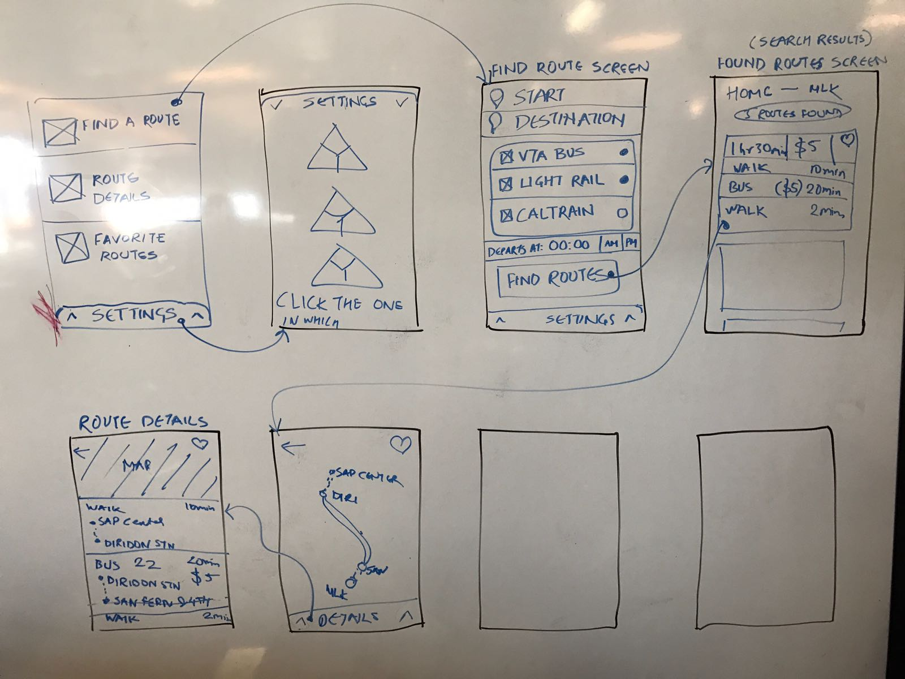
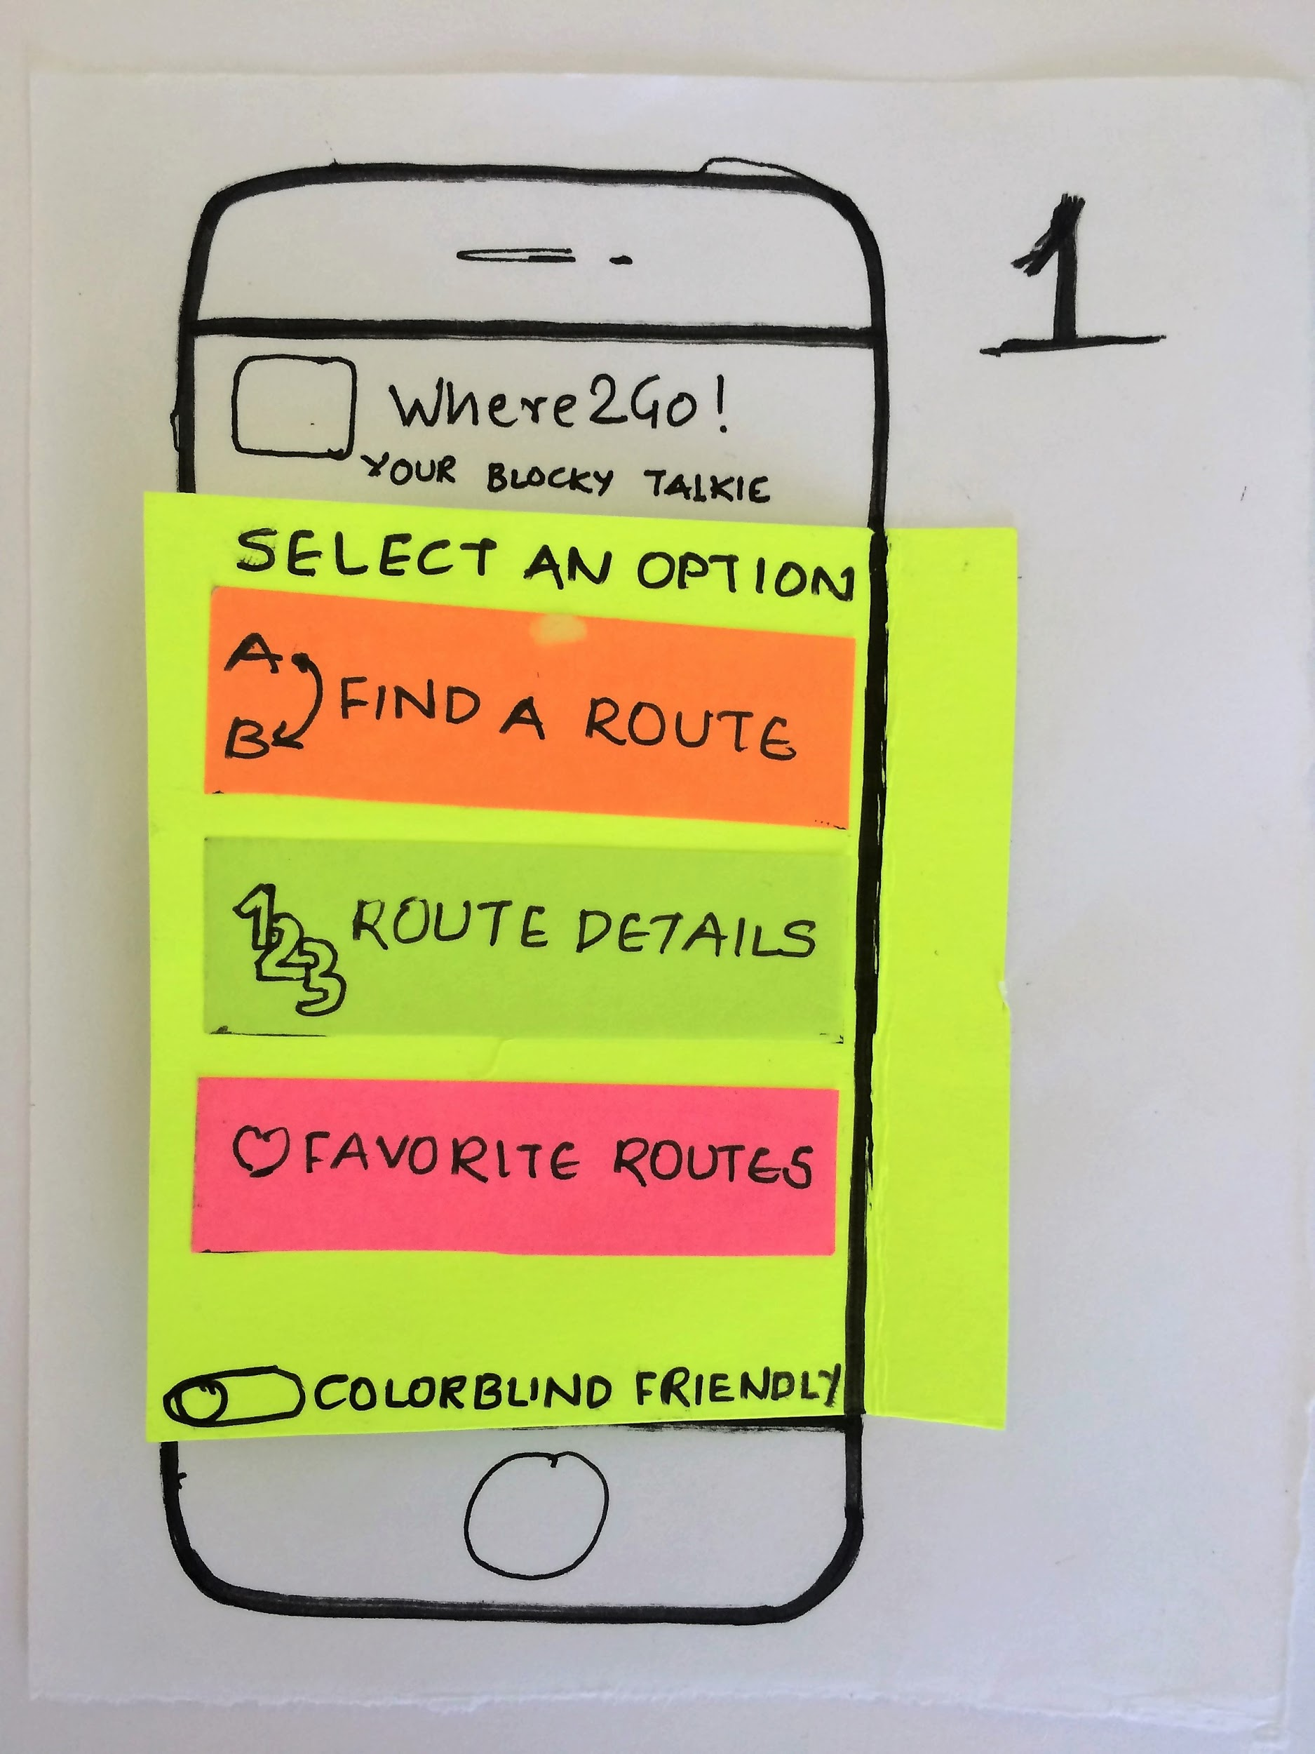
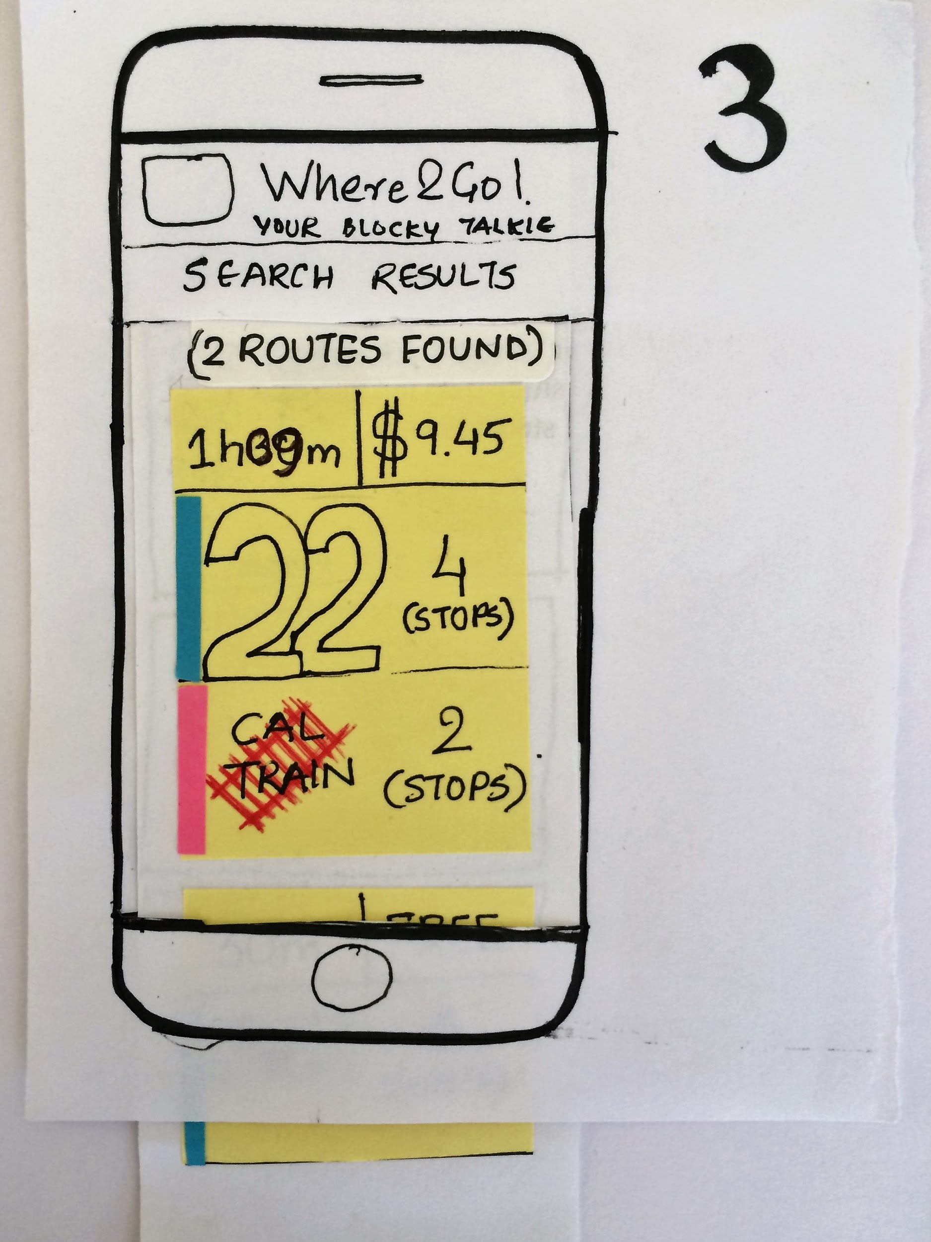
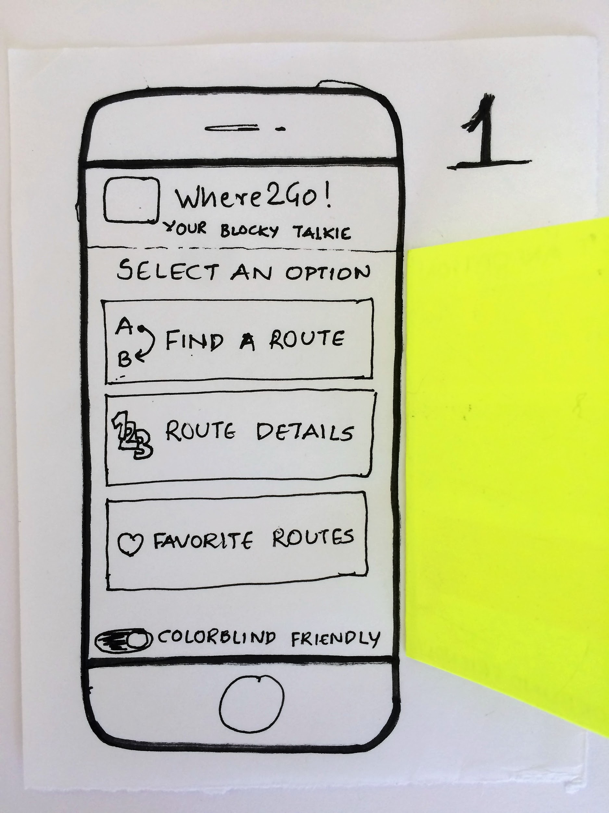
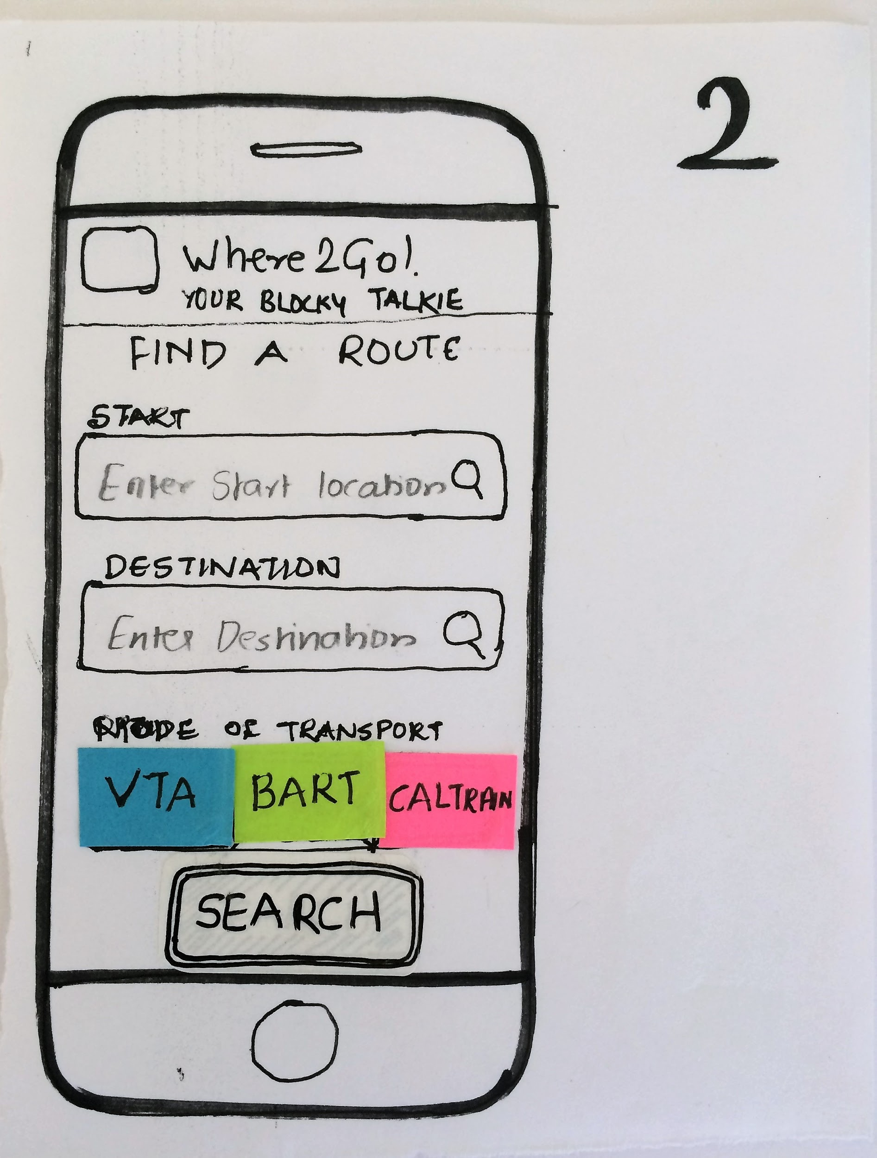
Iterations
From storyboarding to wireframing to paper prototyping to hi-fi prototyping

Slide 5
Tools
Google Drawing
Pixate
Atomic
Mockingbot
Prototyping

Slide 6
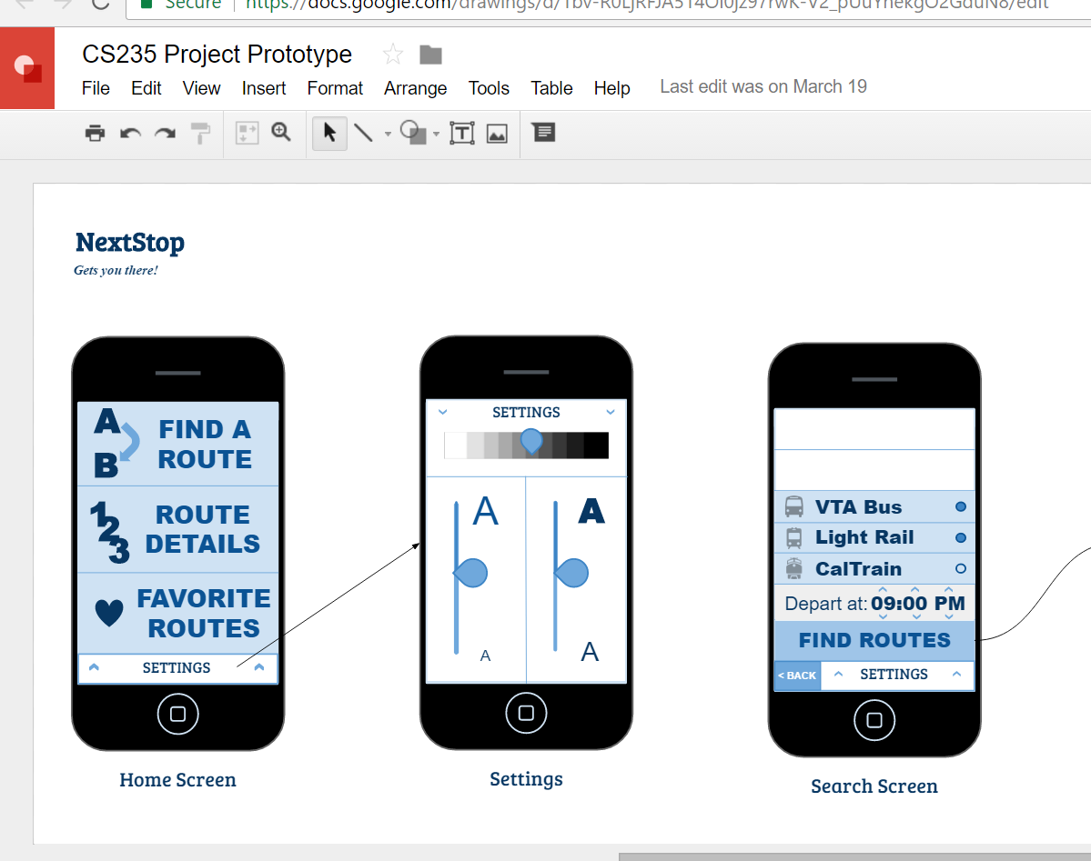
Google Drawing
Static! No interactivity
Barely any advantage over paper-prototype
Does support collaboration seamlessly
Free!

Slide 7
Atomic
Pixate
Extremely powerful
Paid
Steep learning curve
Supports Collaboration
Extremely powerful
Free
Steep learning curve
Desktop tool
Not supported anymore

Slide 8
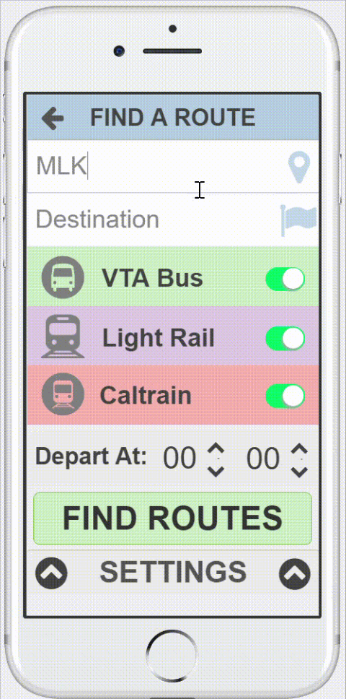
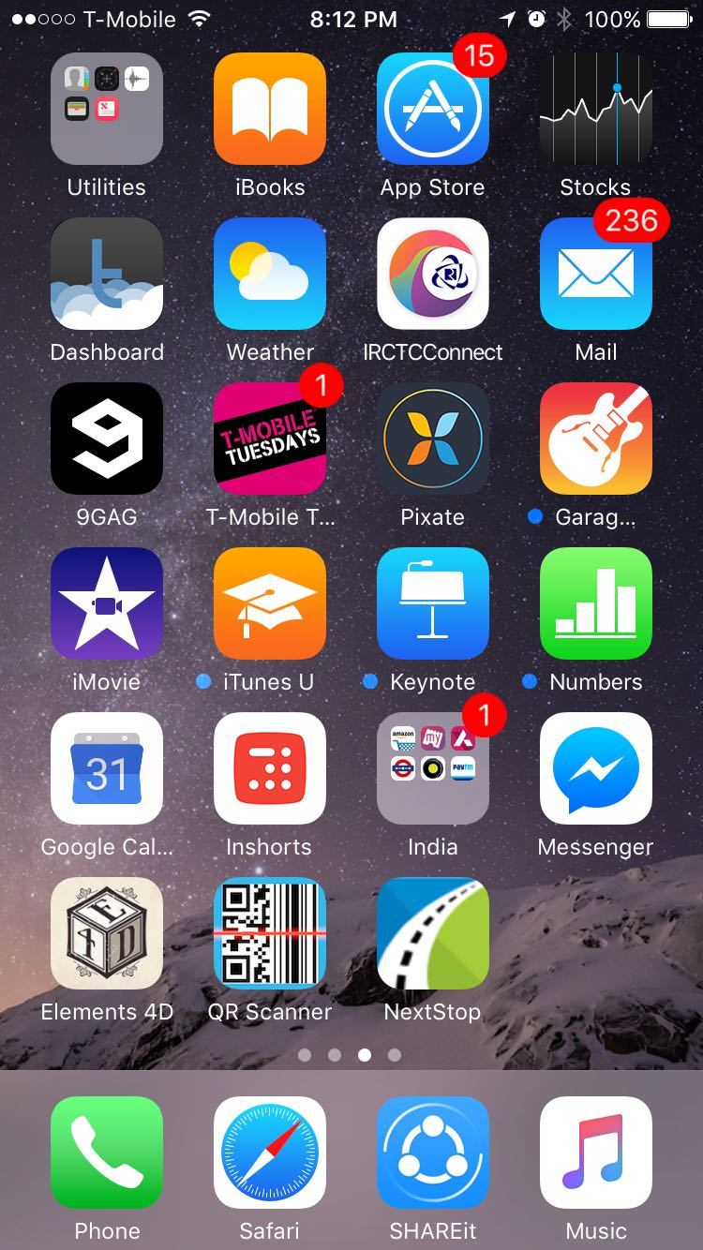
Mockingbot
Extremely powerful
Paid but cheap
Easy to use
Supports collaboration
Allows icon on home screen and splash screen on launch

Slide 9
Accessibility
Colorblind-friendly mode
Auditory assistance
Pattern based design
Larger font sizes
Decluttered interface
With an overkill!

Slide 10
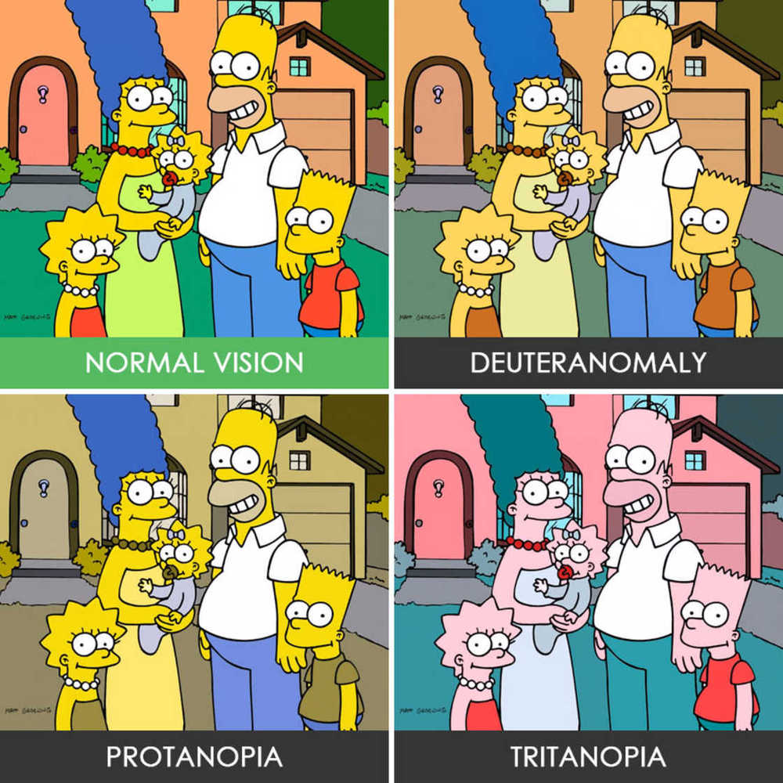
Accessibility: Concerns
Deuteranopia or deuteranomaly
5% of all males.
Protanopia or protanomaly
2.5% of all males.
Tritanopia
Less than 0.3% of women and men.
What about loss of sight due to old age?

Slide 11
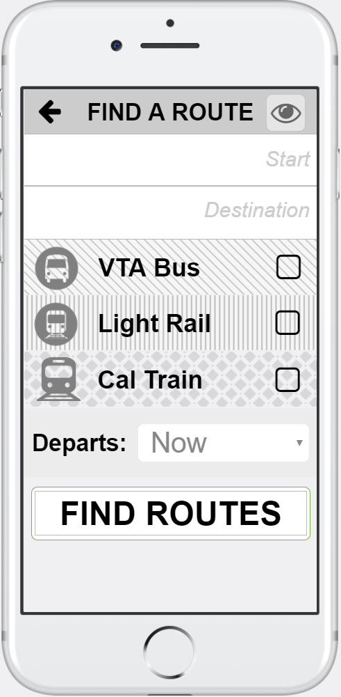
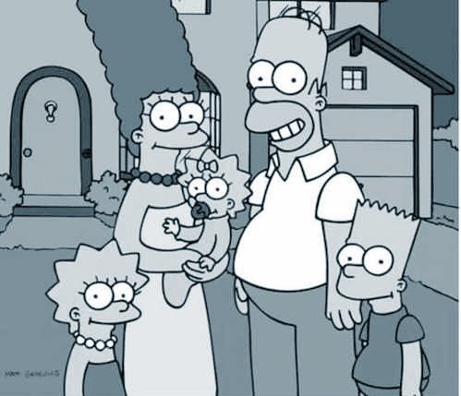
Accessibility: The Solution
‘Black & White’ for the win!
Auditory assistance
Pattern based design
Larger font sizes

Slide 12
Project Management
Canvas
Bi-weekly meetings in the library
10-min stand up meetings every week

Slide 13
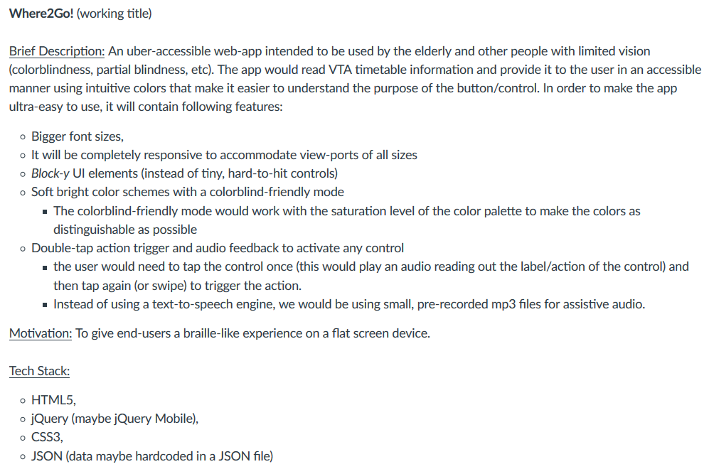
The beginning...

Slide 14
Division of Labor
Before
After
Avinash More
Krithika Raghavendran
Nicolas Mauthes
Vikram Deshmukh
Vishrut Sharma
Avinash More
Krithika Raghavendran
Nicolas Mauthes
Vikram Deshmukh
Vishrut Sharma
Business Analyst .
Coder .
Business Analyst .
Designer .
Solution Architect .
Coder .
Project Manager .

Slide 15
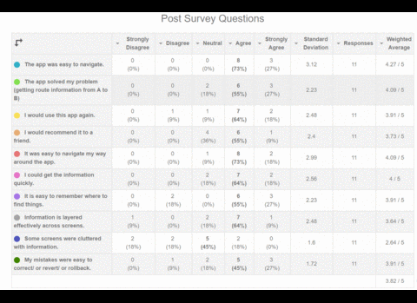
User Testing (Feedback)
3 in-class rounds of user testing
Feedback received was incorporated the app before the next round
Tested by almost a dozen users in class and more
Both qualitative and quantifiable feedback

Slide 16
Use Scenarios
Dr Jekyll wants to find the cheapest route to get from SAP Center to MLK Library that involves minimal walking.
Mr Hyde frequently uses a particular route when indulging in his escapades. But the traffic and time of the day impacts the time taken for the commute. He would like to easily check how long it would take to travel on that route just before leaving.

Slide 17
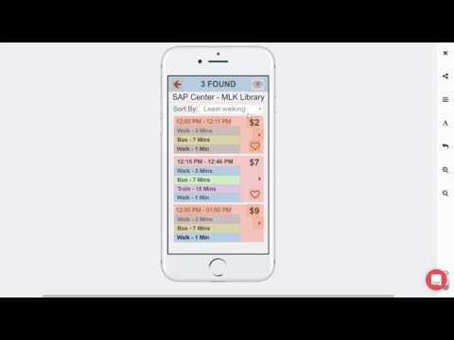

Slide 18
Future Prospects (including monetization strategy)
NextStop will stay free for use and available to all
No paid subscriptions
No in-app ads
May rely on donations from users (a la Wikipedia)
Could be advertised on message boards for the visually impaired
(e.g. American Foundation for the Blind, visionaware.org)
In the future we plan to make the app open source

Slide 19
Lessons learned
Usability Testing is imperative to the product's’ success.
Also this is an ongoing process.
Prototyping is a time-saving way of refining product design.
‘Thinking out of the box’ is important! Radical yet simple designs entice users to engage with the app more.
Pivot, Improvise, Evolve!
The apple doesn’t fall far from the tree!

Slide 20
Thank you

